Slide 1
Fibre Optics

Slide 2
Optical Fibre
Optical Fibre is an optical transmission device which works on the principle of total internal reflection.
Principle of Optical Fibre
When a light signal is directed at one end of the fibre at a suitable angle, it undergoes repeated total internal reflection along the length of the fibre and finally comes out at the other end.

Slide 3
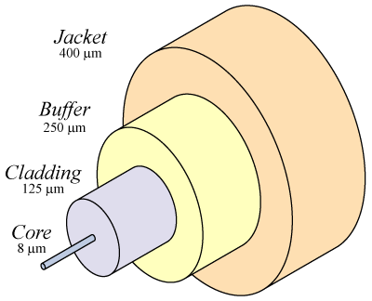
Optical Fiber
Core
  Glass or plastic with a higher index of refraction than the cladding
  Carries the signal
Cladding
  Glass or plastic with a lower index of refraction than the core
Buffer
  Protects the fiber from damage and moisture
Jacket
  Holds one or more fibers in a cable

Slide 4
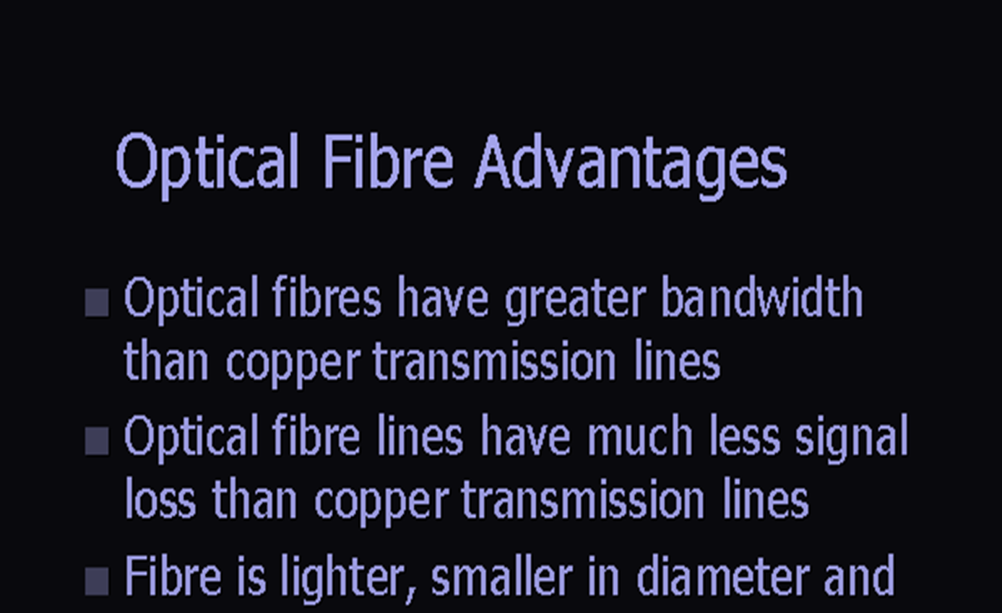

Slide 5
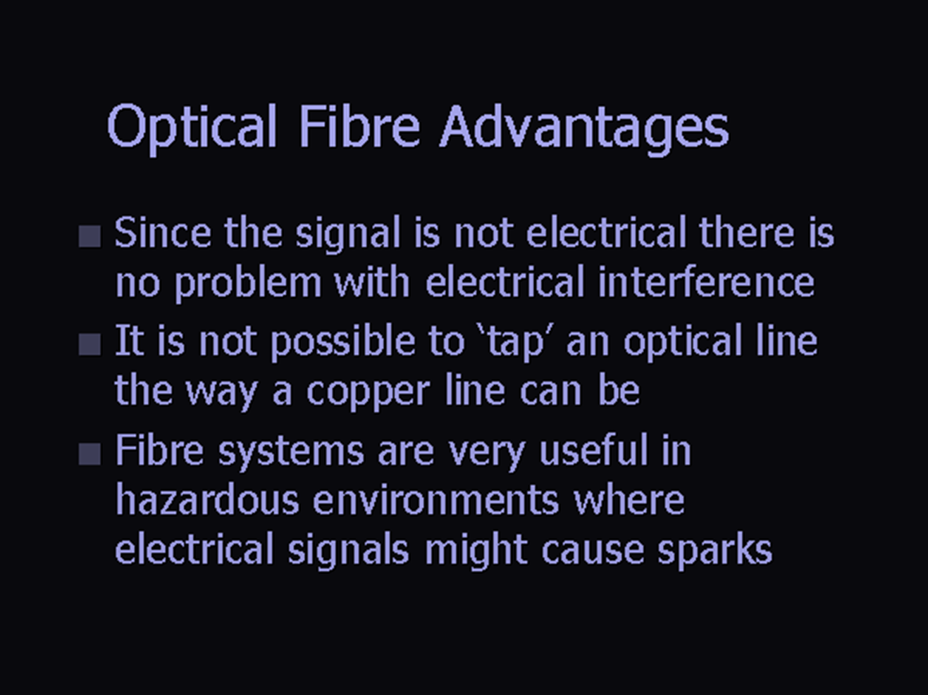

Slide 6
Potential low cost of raw material but high cost in installation: The glass which generally provides the optical fiber transmission medium is made from sand (SiO₂).
Enormous band width: The optical carrier frequency in the range 10¹³ to 10¹⁶ Hz.
In metallic cable systems band width is 500-700 MHz's. The amount of data that can be transmitted in a fixed amount of time.
Signal security: Optical fibers provides the high degree of signal security.
Using an Optical fiber, 15000 independent speeches can be sent where as using a pair of copper wires, only 48 independent speeches can be sent

Slide 7
Types of Optical Fibre (Based on core size)
Single Mode / Monomode Fibre
Multimode Fibre
Multimode
Step Index Fibres
Multimode
Graded Index Fibres

Slide 8
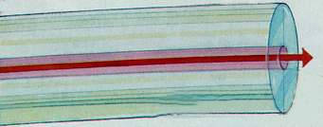
Single Mode Step Index Fiber
Single mode step index fiber has a core diameter of 8 to 9 microns, which only allows one light path or mode
Single mode fibres have a lower signal loss and a higher information capacity or bandwidth than a multimode fibre.
Index of refraction

Slide 9
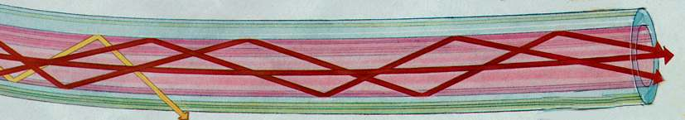
Multimode Step-Index Fiber
Multimode fiber has a core diameter of 50 to 100 microns (sometimes even larger)
  Allows several light paths (~100) or modes
  This causes modal dispersion – some modes take longer to pass through the fiber than others because they travel a longer distance
Index of refraction

Slide 10
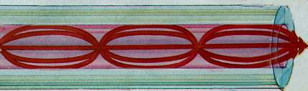
Multimode Graded-Index Fiber
The index of refraction gradually changes across the core
  Modes that travel further also move faster
  This reduces modal dispersion so the bandwidth is greatly increased
Index of refraction

Slide 11
Step-index and Graded-index
Step index multimode was developed first, but rare today because it has a low bandwidth (50 MHz-km)
It has been replaced by graded-index multimode with a bandwidth up to 2 GHz-km

Slide 12
Fiber Optic Specifications
Attenuation
  Loss of signal, measured in dB/km
Dispersion
  Blurring of a signal, affects bandwidth
Bandwidth
  The number of bits per second that can be sent through a data link
Acceptance angle
  Measures the largest angle of light that can be accepted into the core

Slide 13
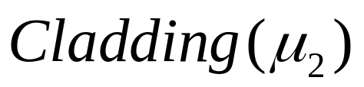
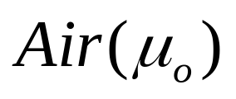

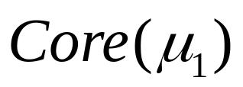



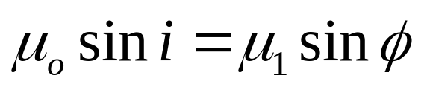
Acceptance Angle
Optical fibre will only propagate light that enters the fibre within a certain cone, known as acceptance cone of the fibre. The half-angle of this cone is called the acceptance angle (θ_{i})
From Snell’s law

Slide 14
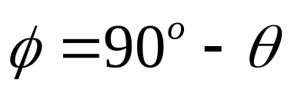
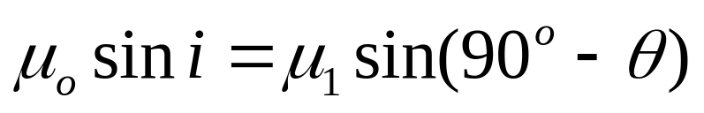
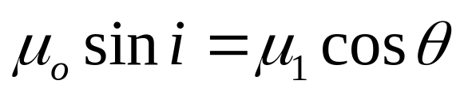
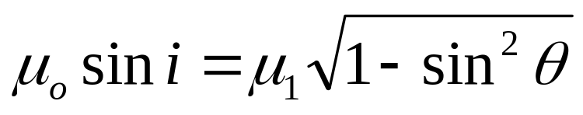
If i increases, Φ increases and θ decreases.
There is a maximum value of i beyond which the light ray entering the fibre will fall on the core-cladding interface at an angle less than θ_{c}. Such a ray will be refracted into the cladding and will not propagate. This maximum value of i, say i_{max} is called the acceptance angle of the fibre.

Slide 15
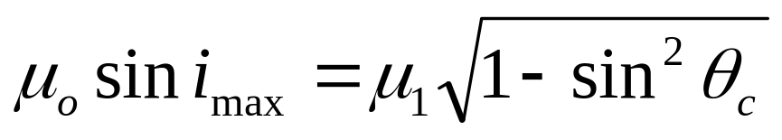
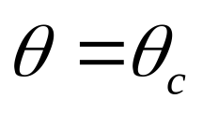
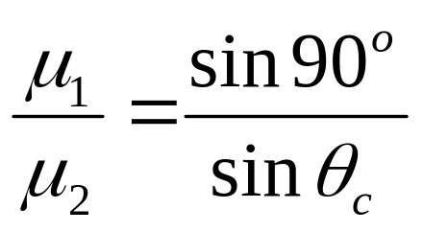
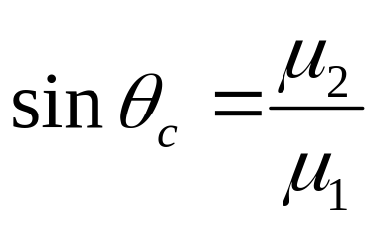
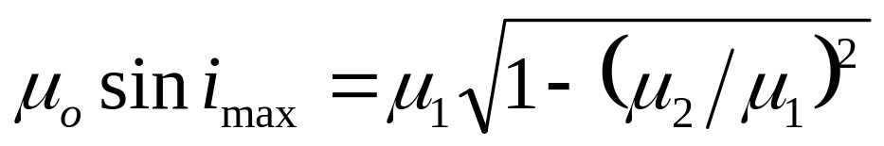
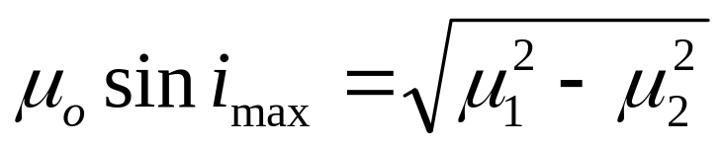
When then according to Snell’s law

Slide 16
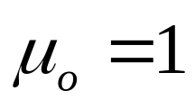
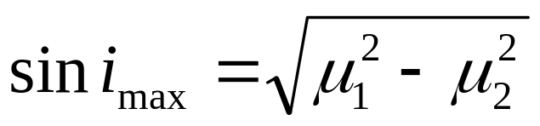
Taking for air, we get
This equation gives a relation between the acceptance angle and the refractive indices of the core and the cladding.
The cone associated with the angle i_{max} is called the acceptance cone.

Slide 17
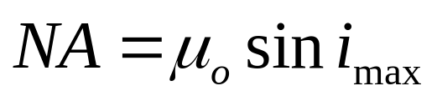
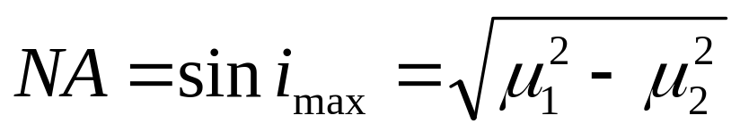
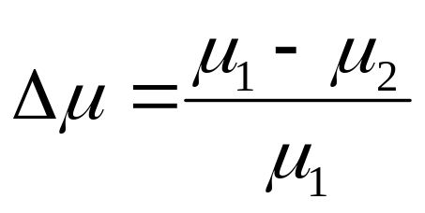
Numerical Aperture
It is the measure of the light gathering capacity of the fibre and is defined as the product of sine of the acceptance angle and the refractive index of the medium to which the end faces of the fibre are exposed.
Taking for air, we get
Relative index

Slide 18
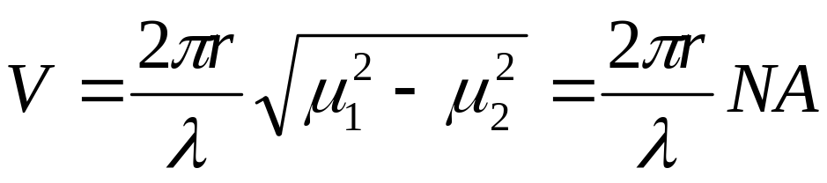


V Number
The number of modes of multimode fiber cable depends on the wavelength of light, core diameter and material composition. This can be determined by the Normalized frequency parameter (V) or mode volume no.
Where , r = radius of fiber core;
λ = wavelength of light
NA=numerical aperture
Mathematically, the number of modes for a fiber is given by:
For Step-index
For Graded-index

Slide 19
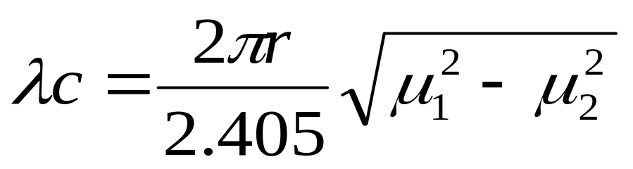
Cut off wavelength
NOTE:
1. For a single mode fiber, V < 2.405
2. For multimode fiber, V > 2.405
3. Cut off wavelength is wavelength corresponding to V=2.405

Slide 20

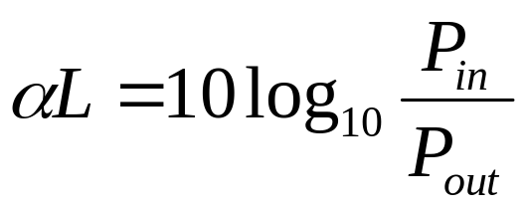
ATTENUATION
Attenuation or transmission loss is the loss of optical power as light travels down a fiber. It is due to impurities in glass fiber or due to absorption of fiber.
The decrease in signal strength along a fiber optic waveguide caused by absorption and scattering is known as attenuation.
Attenuation cofficient is usually expressed in dB/km
Since attenuation is the loss, therefore, it is always expressed as
where α is the attenuation coefficient of the fiber

Slide 21
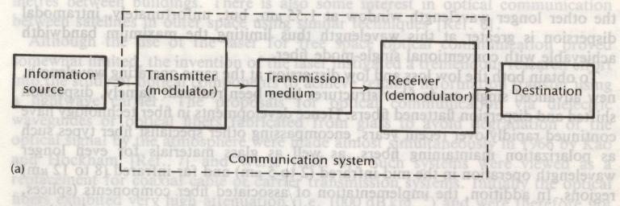
The General Communication System

Slide 22
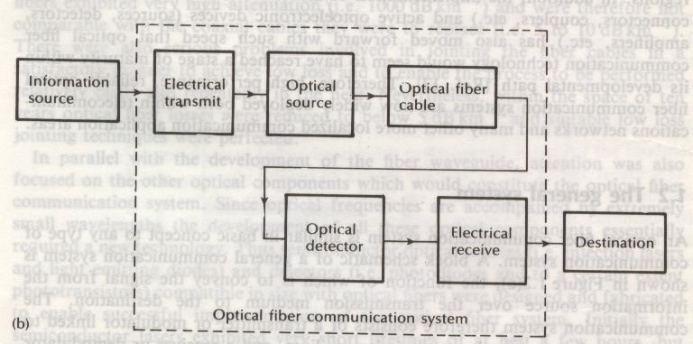
The Optical fibre Communication System

Slide 23
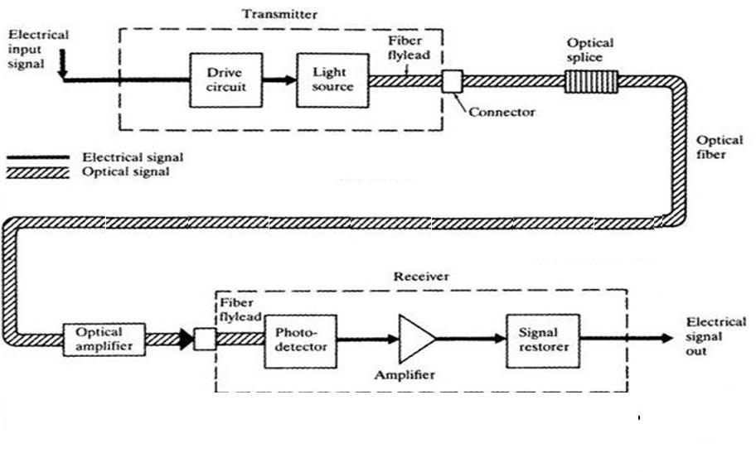
THE OPTICAL FIBER COMMUNICATION SYSTEM

Slide 24
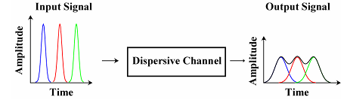
Dispersion
Dispersion, expressed in terms of the symbol ∆t, is defined as pulse spreading in an optical fibre.
As a pulse of light propagates through a fibre, elements such as numerical aperture, core diameter, refractive index profile, wavelength, and laser line width cause the pulse to broaden. This poses a limitation on the overall bandwidth of the fibre.

Slide 25
Dispersion is of two types:
Internal dispersion/modal dispersion
Intramodal dispersion

Slide 26
Modal Dispersion
Modal Dispersion
  Spreading of a pulse because different modes (paths) through the fiber take different times
  Only happens in multimode fiber
  Reduced, but not eliminated, with graded-index fiber

Slide 27
Intramodal dispersion
It takes place even if only one mode is allowed to propagate in the optical fibre and takes place due to following effects:
Material dispersion
Due to the different time taken by different wavelengths to cross the optical fibre if the source is not monochromatic.
(2) Waveguide dispersion
A small portion of light reaches to the output end of fibre through cladding. As refractive index of cladding is less than core, so light through cladding will travel faster. At output end make the pulse broaden at output end.

Slide 28
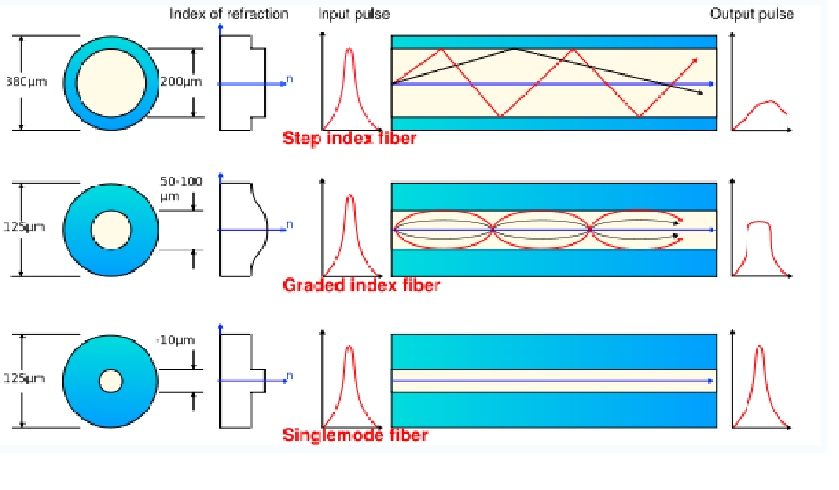

Slide 29
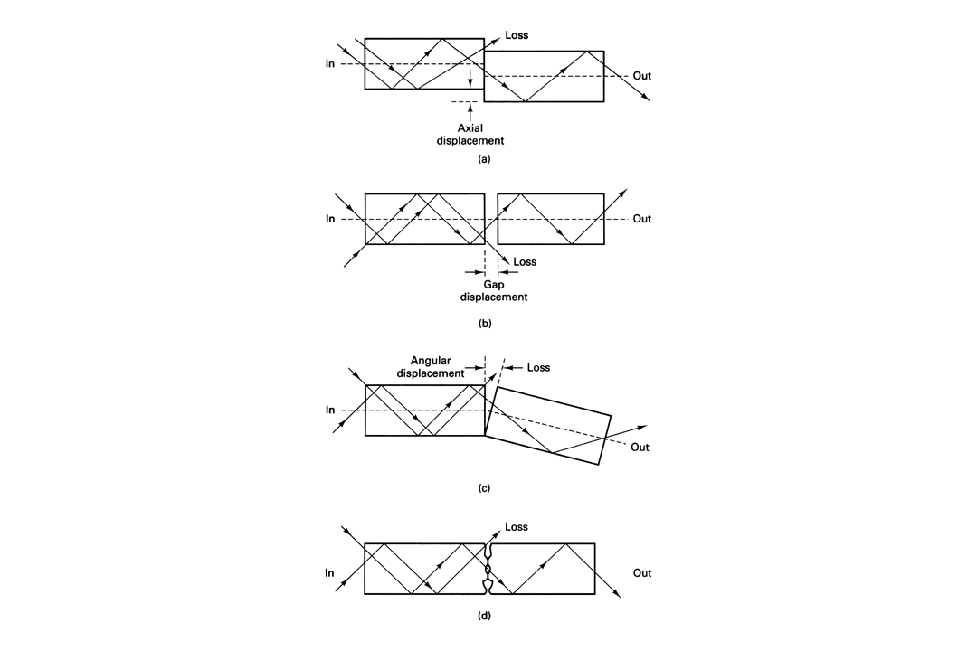
Coupling Losses
Loss splice (or fuse) < 0.02 dB
Loss connector ± 0.5 dB

Slide 30
